Slide 1
Geodetic Acoustic Ray Solutions in the Time Domain
Mr. Sean Reilly
University of Rhode Island
Ocean Engineering Department
January 2011

Slide 2
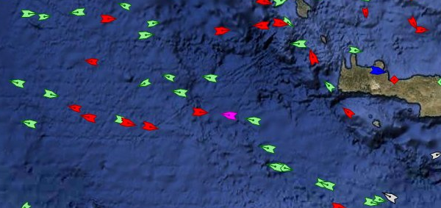
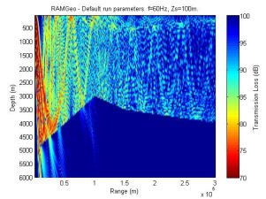
Real-Time Gaming in Littoral
AIS merchant ship traffic report from MarineTraffic.com on 02-16-10
TL image from http://cmst.curtin.edu.au/products/actoolbox/
Can we make this faster and better by re-visiting the fundamental assumptions behind the models?

Slide 3
Goals
Construct an ocean acoustics propagation model based on ray theory.
Optimized for real-time, sonar simulation/stimulation in littoral environments.
Focus on sonar frequencies > 250 Hz
Basis for follow-on work in fast reverberation modeling.
Using modern software engineering techniques.
Overcome shortcomings in existing ray models
Speed – Requires a rack of computers to run.
Integration – Designed as a standalone system instead a small part of a larger system.
Special Interface – Requires developers to learn new scripting language or GUI developed just for this model.
Maintainability – Focuses on initial development effort instead of long term re-use and re-factoring.

Slide 4


Deliverables
Mathematical Foundations Paper
JCA, JOE Paper?
Software Source Code
Software Design Document (SDD)
Software Test Description (STD)
Verification Test Report (VTR)
JASA Paper?
Validation Test Report
JASA Paper?
Thesis
Draft Complete
≈75% Complete
Not Started

Slide 5
Other Models
Wave number integration – can’t littoral
PE, Normal Modes, FE/FD - impossibly slow.
GRAB – pretty slow, hard to integrate
FeyRay – pretty fast, hard to maintain
BellHop, Harpo, RRA – more study required

Slide 6
New Assumptions
Geodetic system avoids translation of environmental data into series of 2-D radials.
Reduced data extraction costs significantly contribute to decrease in total speed budget.
Numerical integration in the time dimension
Maintaining continuity of wavefront improves eigenray estimation with reduced number of rays.
Hybrid Gaussian beam extends applicability of ray theory to lower frequency regimes.
But best accuracy for frequencies > 1000 Hz.
Advances in C++ numerical computing techniques improve speed and maintainability.

Slide 7

Mathematical Foundations
First draft of paper complete.
Ray theory
Reflection
Eigenrays
Gaussian beams
Earth’s axis
area of operations
h
R
center of
equator
the earth
latitude
center of
curvature
longitude
Use WGS-84 ellipsoid to approximate a local spherical polar coordinate system

Slide 8

Under Sea Modeling Library
Not fully tested.
Gaussian Beams need work.
Geodetic Acoustic Rays
Focus on TDD and Literate Programming
Wave Fronts
Eigenray Results
Proploss Results
NetCDF Files
Fundamental Data Types
Ocean Components
Bathymetry
Ocean Profiles
COARDS, WOA, ETOPO
Data Grids
Sequences
World Coordinates
Profiles
Attenuation
Boundaries
Reflection Loss
Modeling foundations complete
uBLAS Extensions
uses
abs, arg, sqrt, max, ...
cos, acos, cosh, acosh, ...
exp, log, pow, ...
SDD built as part of literate dev process.

Slide 9
Timing Studies
Alion IRAD - July 2006 (Reilly, Goodrich)
Ray tracing components of Geodray 6-20 times faster than equivalent parts of FeyRay.
NWDC V&V – June 2009 (Reilly, Foreman, Fulford)
FeyRay accepted by CNMOC for M&S use.
FeyRay accuracy within 5% of GRAB
FeyRay 5-20 times faster than GRAB
Results contentious – But they support the conclusion that Geodray speed goals may be viable.

Slide 10
Testing
STD built as part of on-going TDD process.
Software Test Description
Does each component work as designed?
Verification Test Report
Classic problems such as Lloyds Mirror, N2 Linear, Munk profile
Model-model comparisons such SWAM99 test cases.
Validation Test Report
Comparisons to sea test data
Re-use FeyRay’s CNMOC approval process
Timing studies
V&V not started.

Slide 11
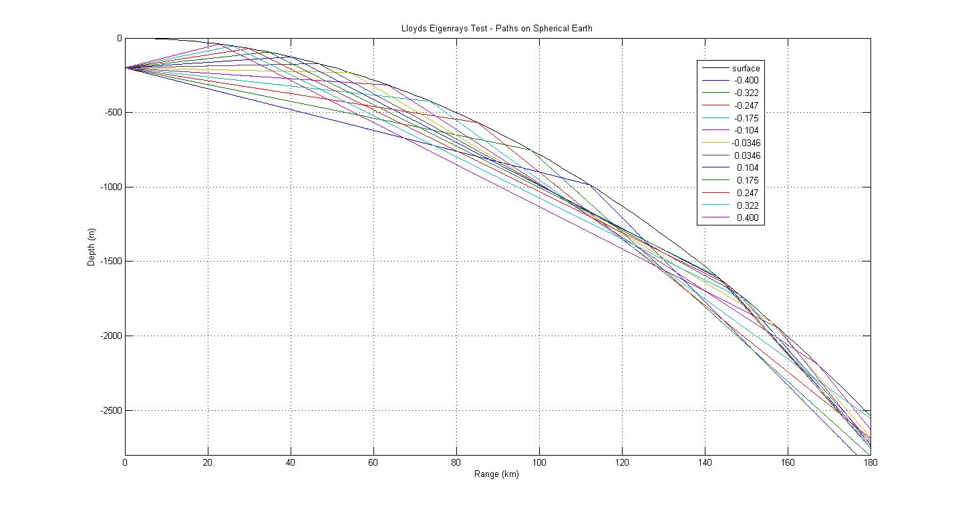
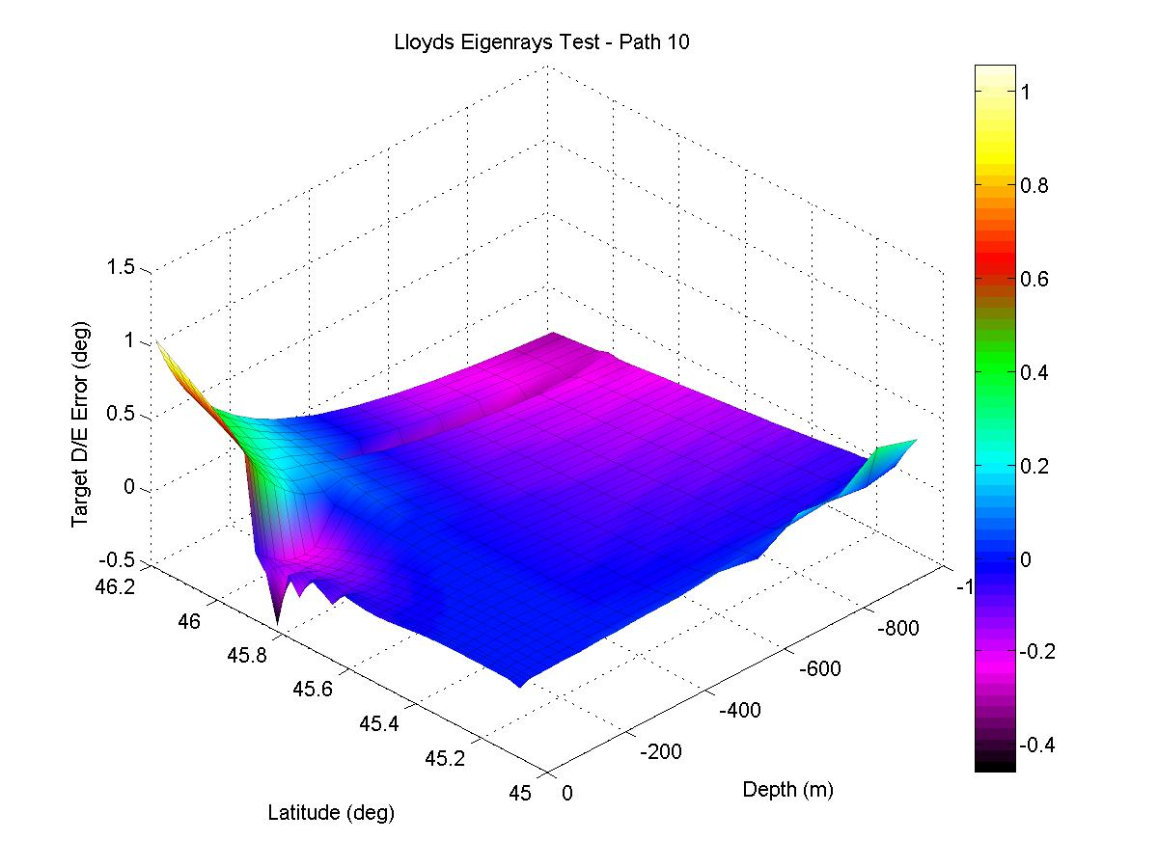
Issues: What changes for classic problems on round earth?
Refocusing
near 100 km
d₁ = source depth d₂ = target depth ξ = target angle ξ ₁ = angle from source to reflection

Slide 12
Issues: Hybrid vs. Full Gaussian Beams?
How valid is Hybrid approach (like Weinberg) when rays diverge?
Does skipping the calculation of dynamic ray equations really save that much time?
Look into Non-Gaussian windowing schemes (like Porter)?
Can alternate schemes for wavefront ray spacing improve environment sampling?
Are there lessons to be learned by analogy to DSP time-frequency windowing?

Slide 13
Further Reading
V. Cerveny, M. M. Popov, and I. Psencik, “Computation of wave fields in inhomogeneous media – Gaussian beam approach,” Geophys. J. R. Astron. Soc., 70, pp. 109-128, 1982.
R.M. Jones, J.P. Riley, T.M. Georges, “HARPO: A Versatile Three-Dimensional Hamiltonian Ray-Tracing Program for Acoustics Waves in an Ocean with Irregular Bottom,” NOAA, 1986.
M. B. Porter, H. P. Bucker, “Gaussian beam tracing for computing ocean acoustic fields,” J. Acoust. Soc. Am. 82 (4), October 1987.
Ziomek, Lawrence, "The RRA Algorithm: Recursive Ray Acoustics for Three-Dimensional Speeds of Sound," IEEE Journal of Oceanic Engineering, vol. 18 no. 1, January 1993.
H. Weinberg, R. E. Keenan, “Gaussian ray bundles for modeling high-frequency propagation loss under shallow-water conditions.” J. Acoust. Soc. Am. 100 (3), 1421-1431, Sept 1996.
P. A. Baxley, H. Bucker, M. B. Porter, “Comparison of Beam Tracing Algorithms,” Proceedings of the Fifth European Conference on Underwater Acoustics, ECUA 2000.
F. B. Jensen, W. A. Kuperman, M. B. Porter, and H. Schmidt, Computational Ocean Acoustics, American Institute of Physics Press, New York.
The FEYRAY Gaussian Beam Underwater Acoustic Propagation Model, Terry L. Foreman, Navy Warfare Development Center, 5 Jan 2007.

